Slide 1
Case task
RUSSIAN VERSION
07.03.13
Esther Ruigendijk & Bibi Janssen

Slide 2
Practice items

Slide 3
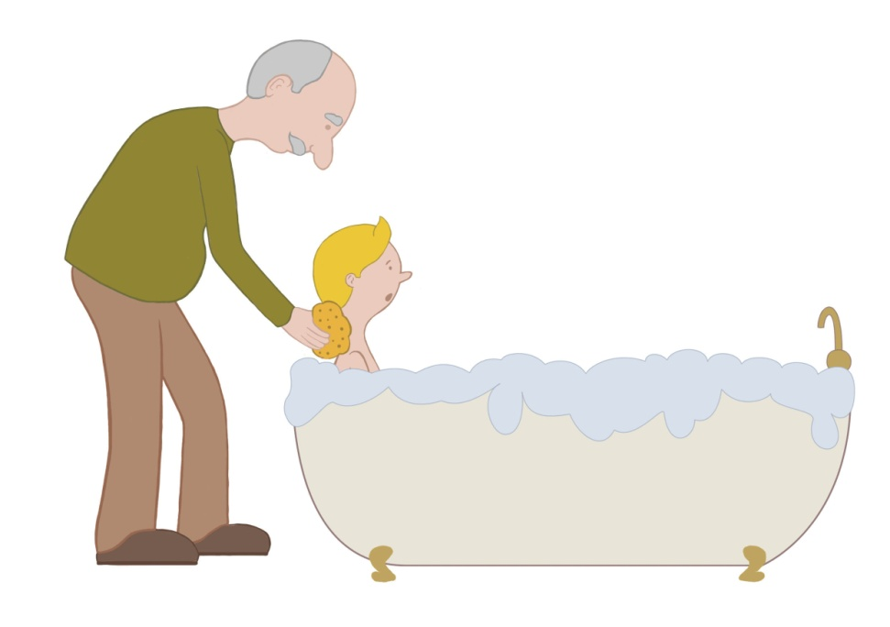
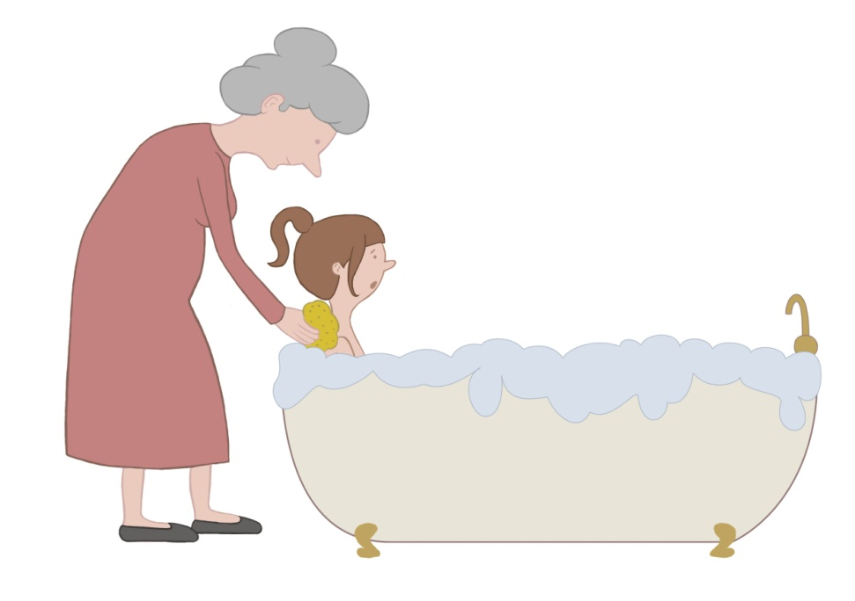
Notes:
Practice item 1: the grandfather washes the boy and the grandmother washes the girl

Slide 4


Notes:
Practice item 2: the man writes the woman a letter and the boy writes the girl a postcard

Slide 5
SVOacc, SVOdat, SVOO
randomized. Russian version, 07.03.13

Slide 6
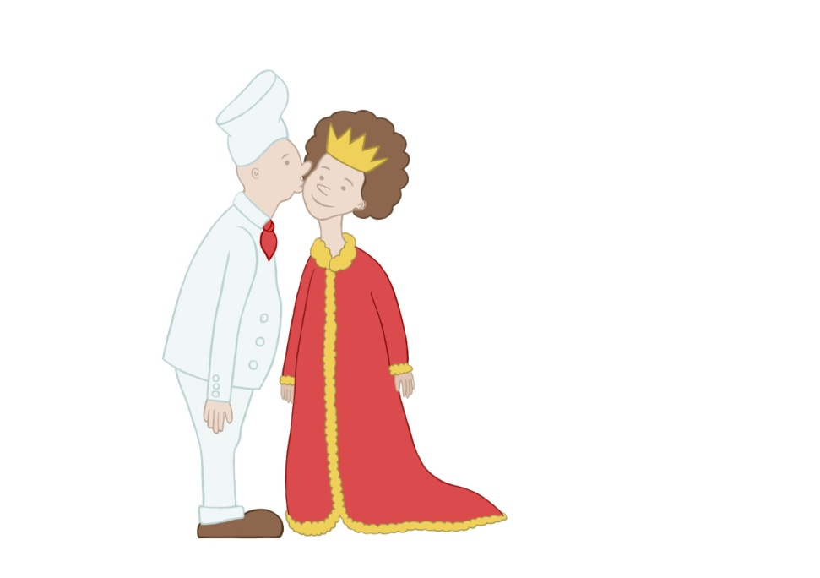
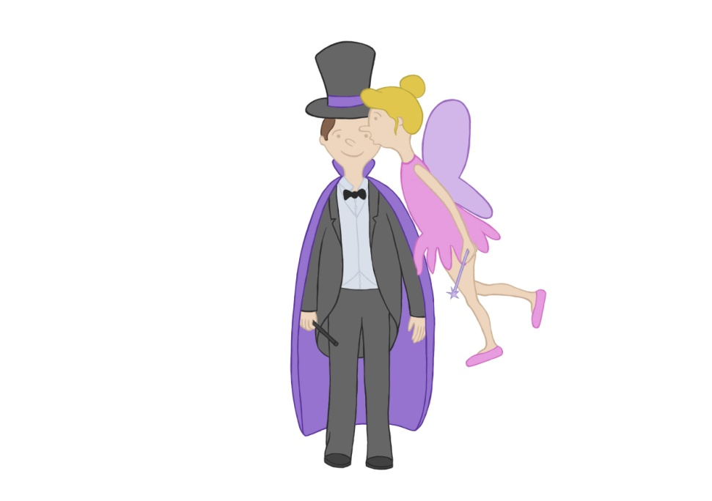
Notes:
4 kissing SnomVOacc the cook (masc) kisses the queen/the fairy kisses the magician

Slide 7
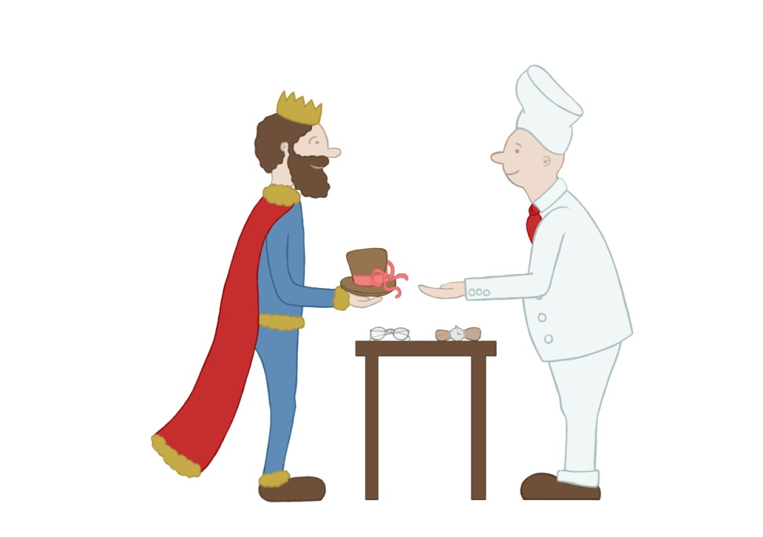
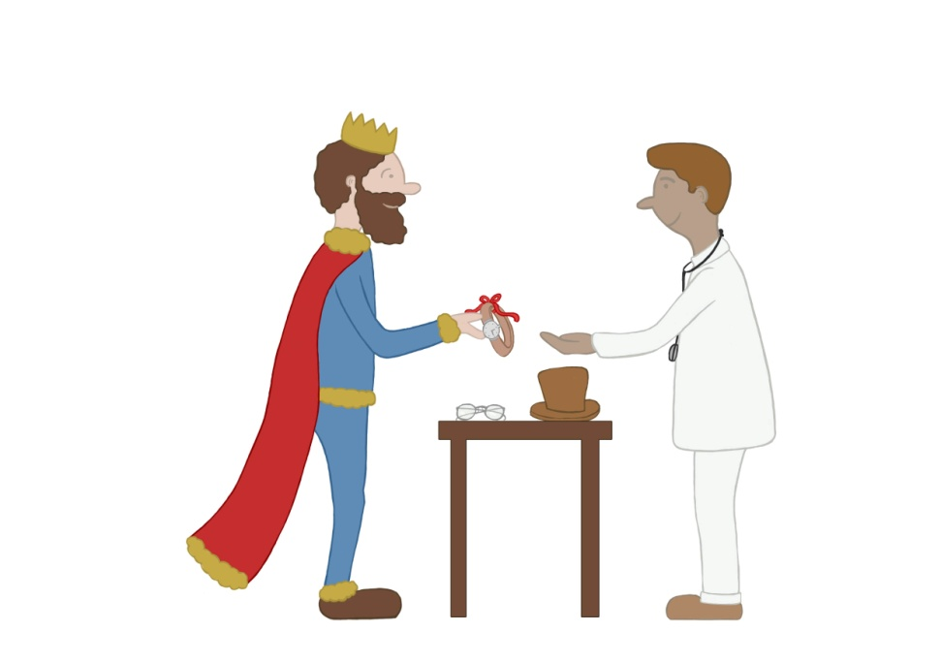
Notes:
4 give SVOO the king gives the cook the hat/ the king gives the doctor the watch (other clothes visible in the pic as well, namely: hat, belt, the hat is wrapped up as a gift)

Slide 8

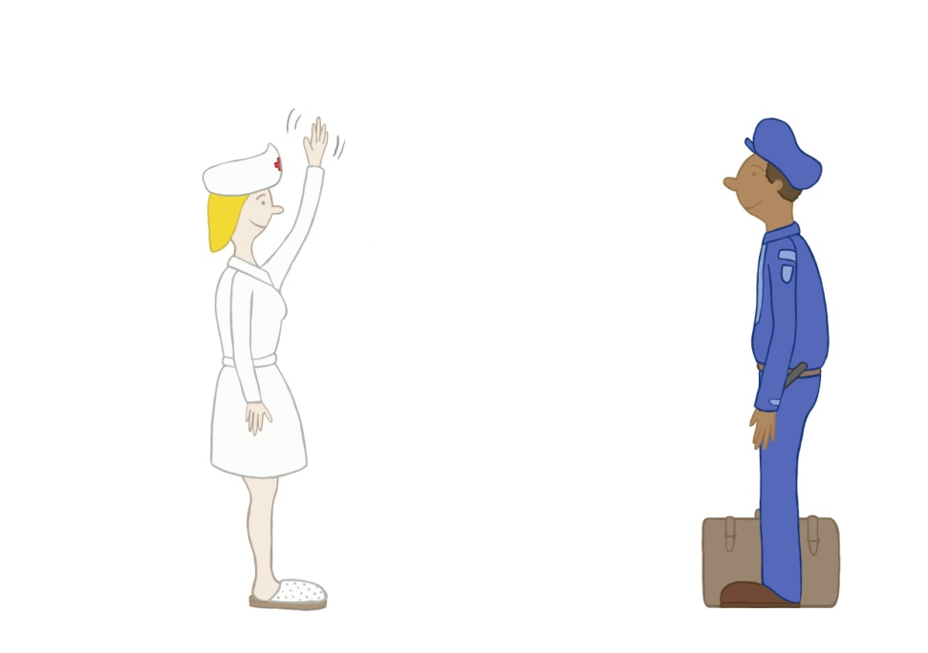
Notes:
3 wave SnomVOdat the clown waves at the fairy/ the nurse waves at the policeman

Slide 9
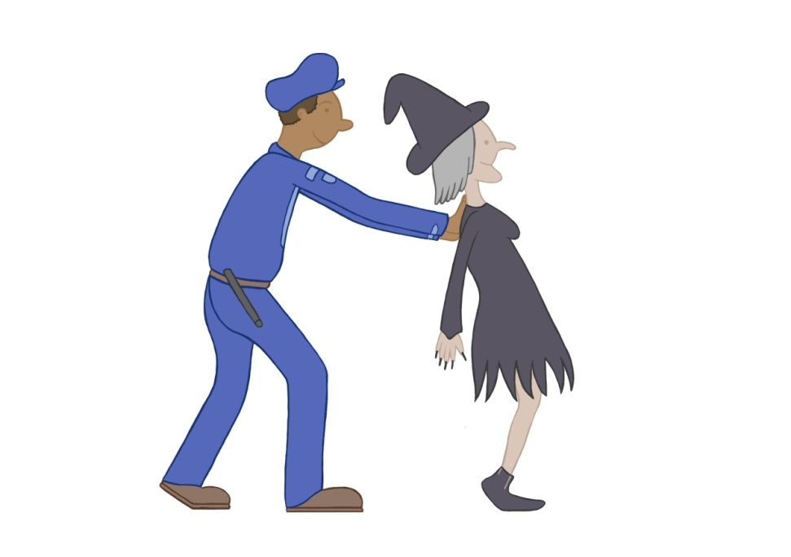
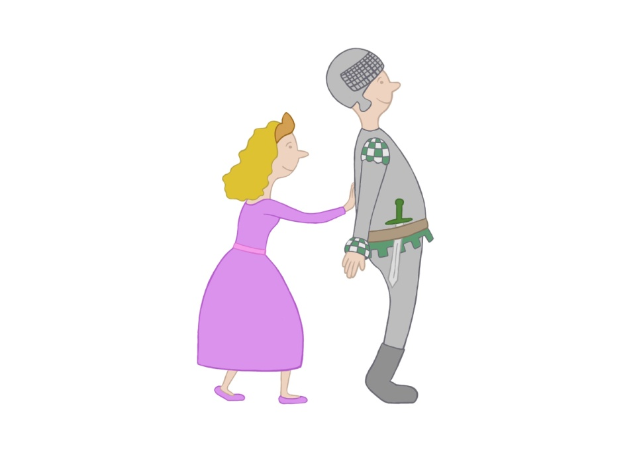
Notes:
1 pushing SnomVOacc the policeman pushes the witch/the princess pushes the knight

Slide 10

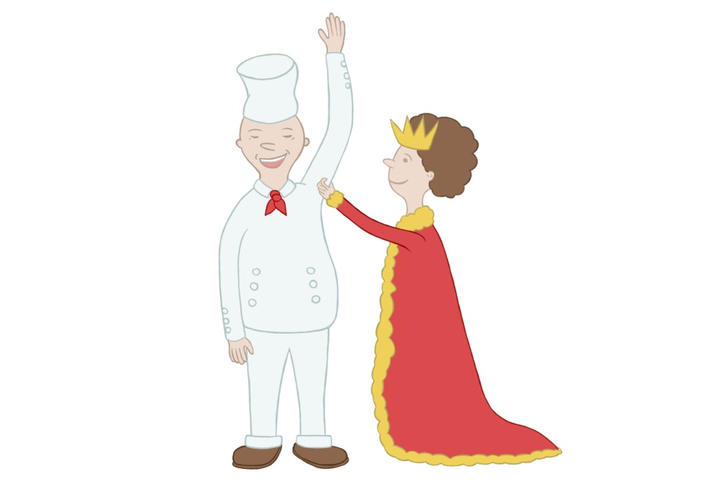
Notes:
5 tickling SnomVOacc the doctor (masc) tickles the nurse/ the queen tickles the cook (masc)

Slide 11
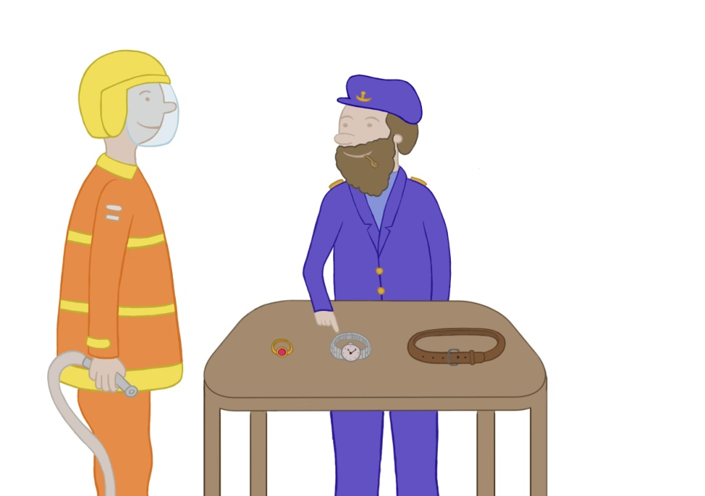
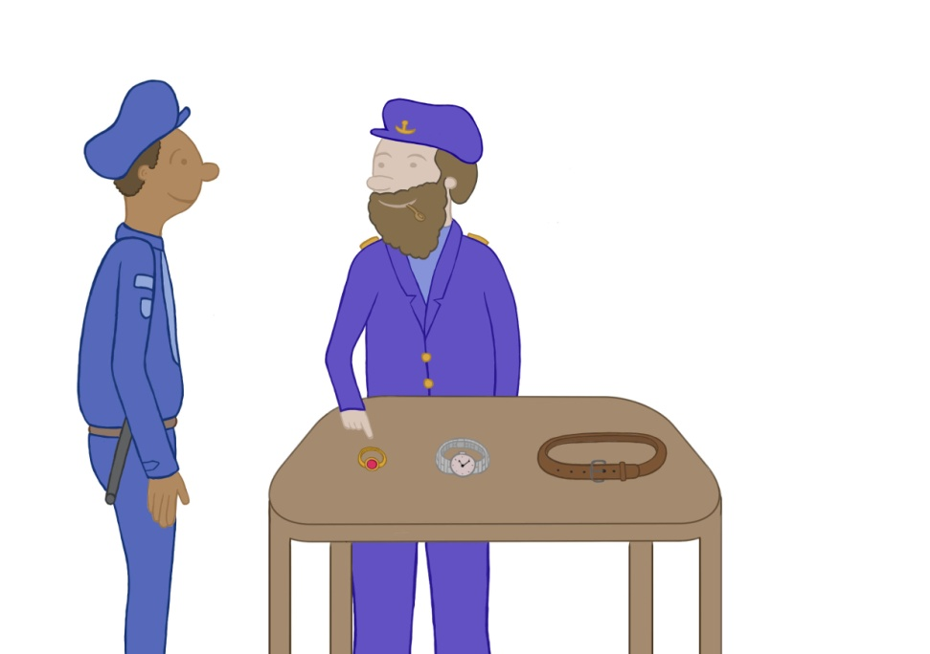
Notes:
2 show SVOO the sailor/captain shows the policeman the ring/// the sailor/captain shows the fireman the watch (also in the picture: a ring, a belt)

Slide 12
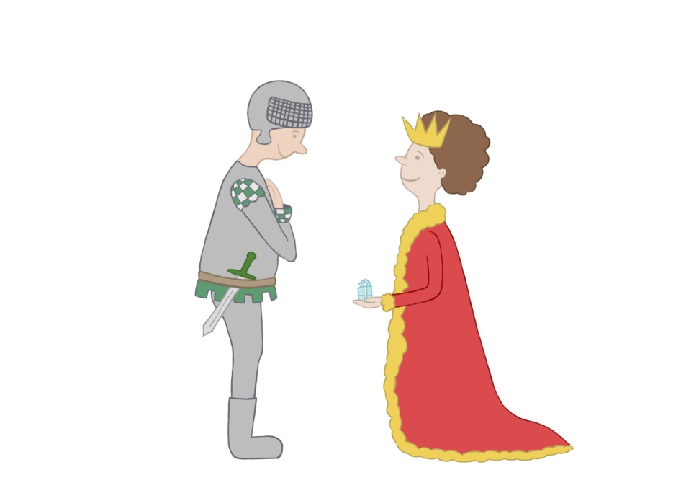
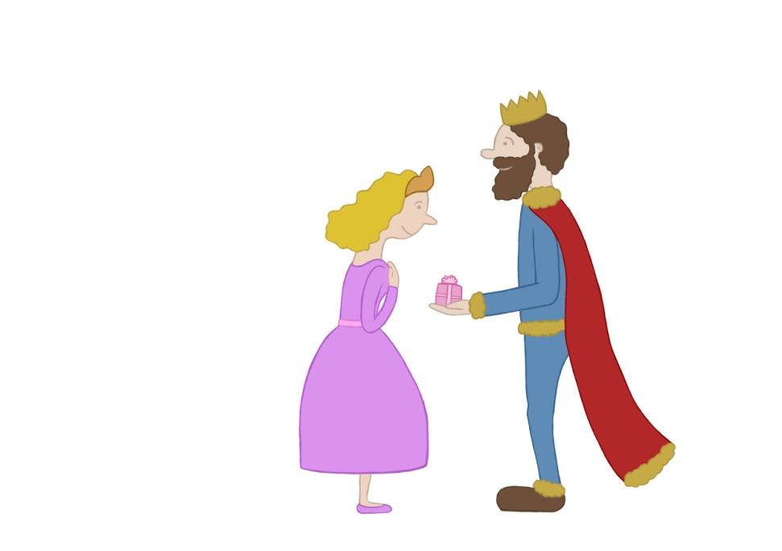
Notes:
1 thank SnomVOO the queen gives the knight a present/ the king gives the princes a present

Slide 13


Notes:
3 send SVOO the clown sends the magician the letter///the clown sends the hunter the booklet (also in the picture a letter a box)

Slide 14
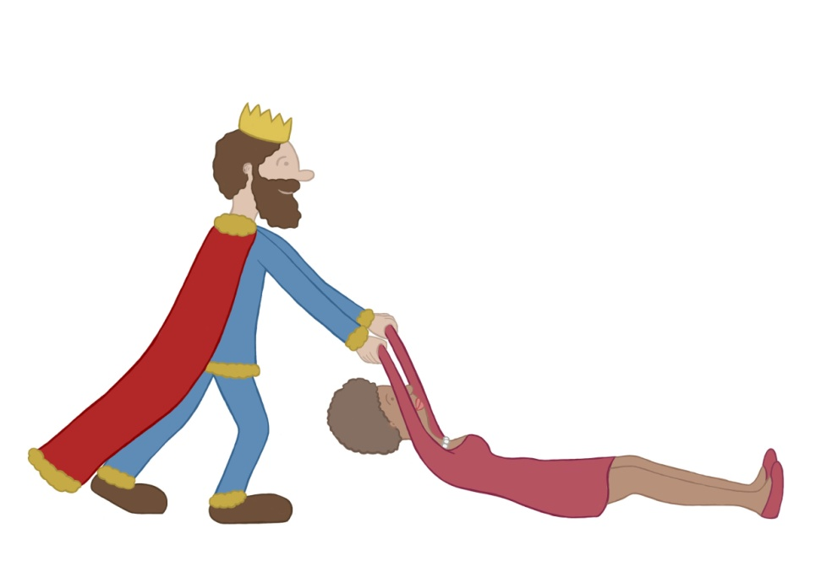
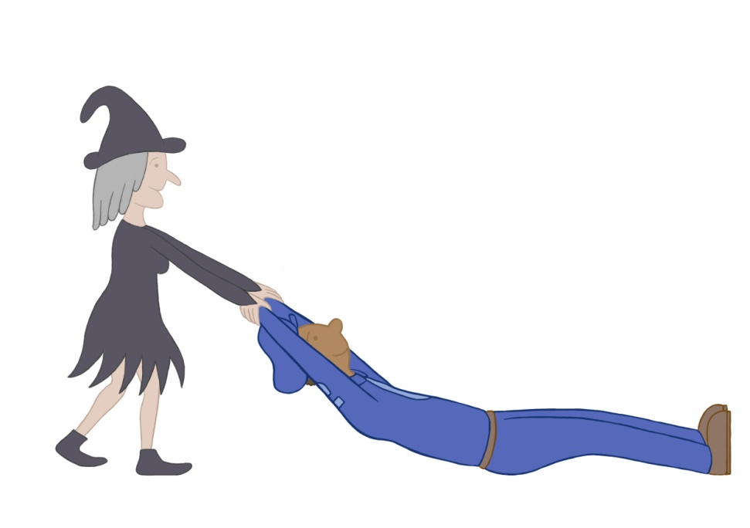
Notes:
2 pulling SnomVOacc the king pulls the woman/ the witch pulls the policeman

Slide 15
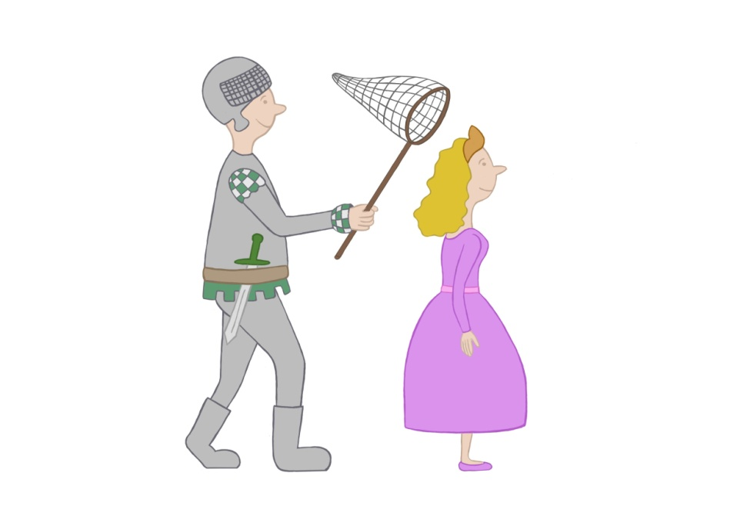

Notes:
6 catch SnomVOacc the knight catches the princess/ the nurse catches the doctor(masc)

Slide 16
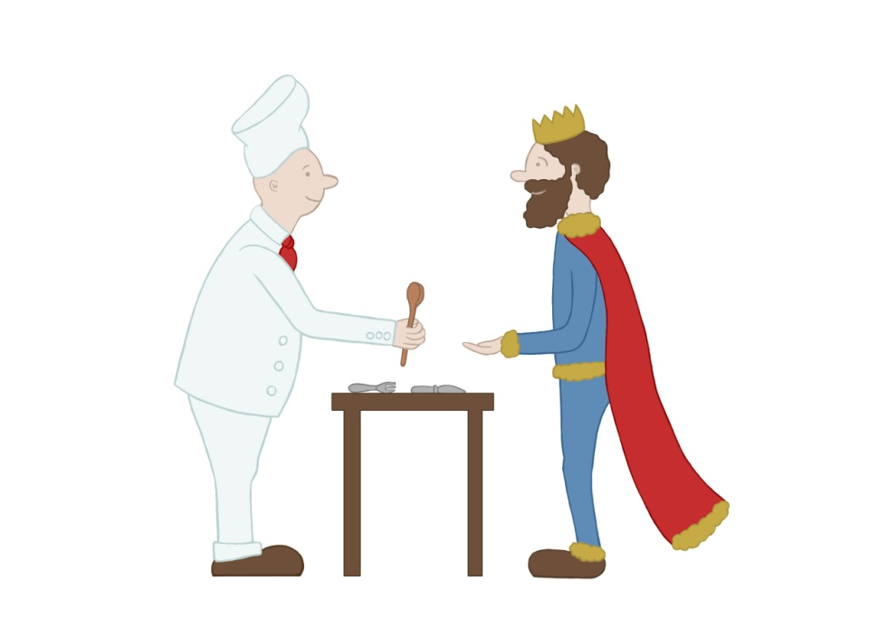
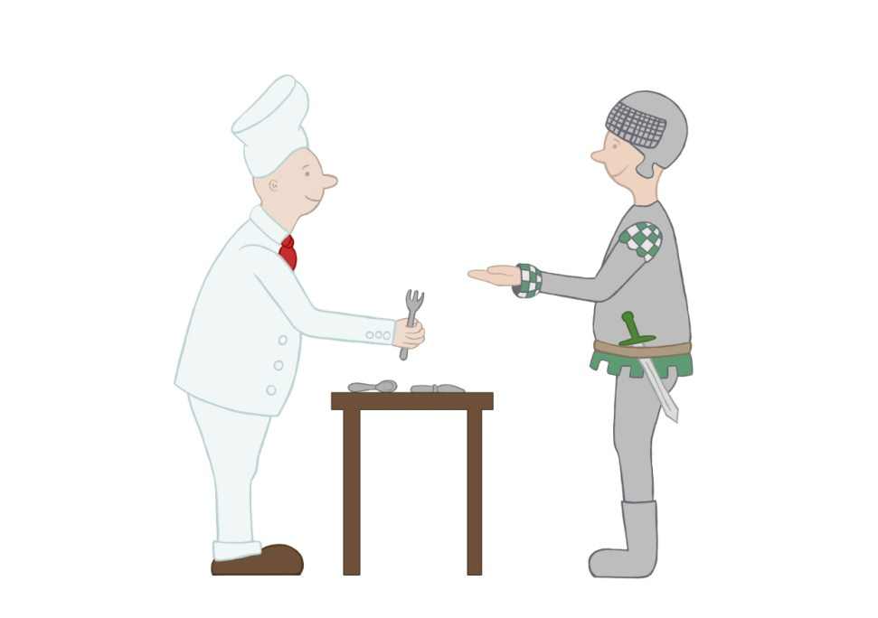
Notes:
1 give SVOO the cook (masc) gives the king the spoon/ the cook gives the knight the fork (other clothes visible in the pic as well, namely: spoon knife)

Slide 17
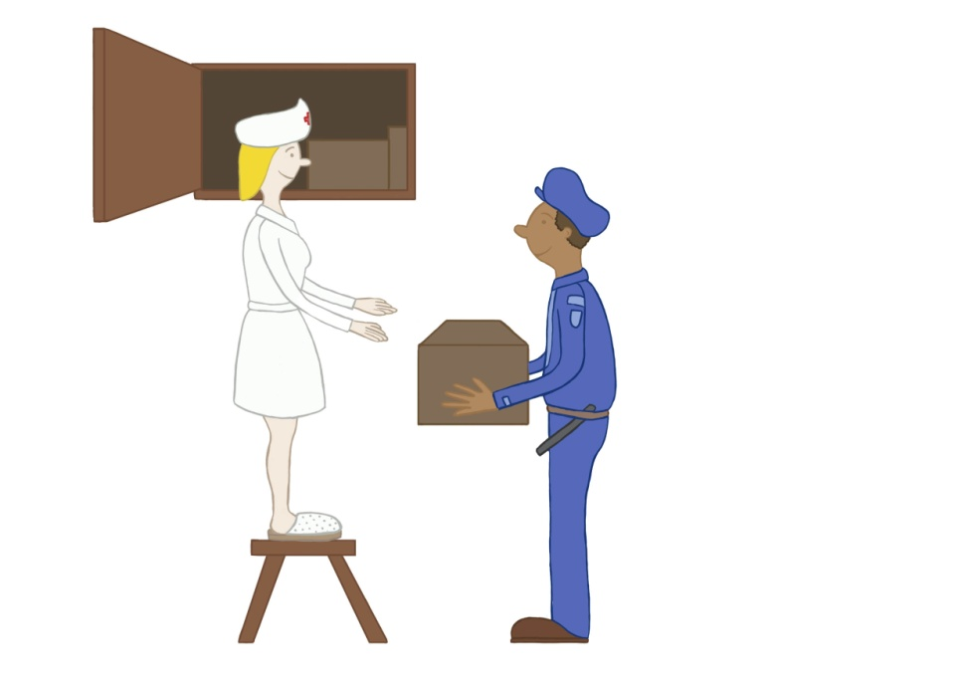
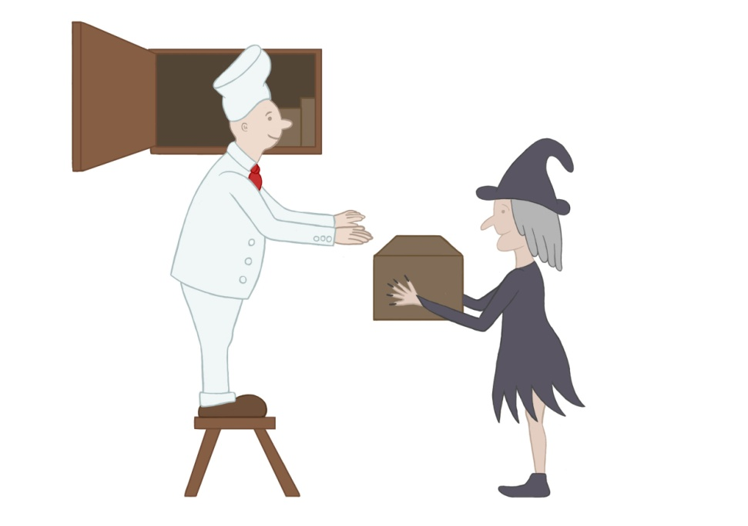
Notes:
4 SnomVOdat the policeman helps the nurse/the witch helps the cook

