Slide 1
Case task GERMAN VERSION
27.08.12
Esther Ruigendijk

Slide 2
Practice items
(for all languages)

Slide 3
Notes:
Practice item 1: the grandfather washes the boy and the grandmother washes the girl

Slide 4
Notes:
Practice item 2: the man writes the woman a letter and the boy writes the girl a postcard

Slide 5
SVOacc, SVOdat, SVOO
randomized. German version, 27.08.12

Slide 6
Notes:
4 kissing SnomVOacc the cook (masc) kisses the queen/the fairy kisses the magician

Slide 7
Notes:
4 give SVOO the king gives the cook the hat/ the king gives the doctor the watch (other clothes visible in the pic as well, namely: hat, belt, the hat is wrapped up as a gift)

Slide 8
Notes:
3 wave SnomVOdat the clown waves at the fairy/ the nurse waves at the policeman

Slide 9
Notes:
1 pushing SnomVOacc the policeman pushes the witch/the princess pushes the knight

Slide 10
Notes:
5 tickling SnomVOacc the doctor (masc) tickles the nurse/ the queen tickles the cook (masc)

Slide 11
Notes:
2 show SVOO the sailor/captain shows the policeman the ring/// the sailor/captain shows the fireman the watch (also in the picture: a ring, a belt)

Slide 12
Notes:
1 thank SnomVOdat the knight thanks the queen/ the princess thanks the king

Slide 13
Notes:
3 send SVOO the clown sends the magician the letter///the clown sends the hunter the booklet (also in the picture a letter a box)

Slide 14
Notes:
2 pulling SnomVOacc the king pulls the woman/ the witch pulls the policeman

Slide 15
Notes:
6 catch SnomVOacc the knight catches the princess/ the nurse catches the doctor(masc)

Slide 16
Notes:
1 give SVOO the cook (masc) gives the king the spoon/ the cook gives the knight the fork (other clothes visible in the pic as well, namely: spoon knife)

Slide 17
Notes:
2 congratulate SnomVOdat the king congratulates the princess/ the fairy congratulates the clown

Slide 18
Notes:
5 follow SnomVOdat the cook(masc) follows the dancer(fem)/ the queen follows the knight

Slide 19
Notes:
5 show SVOO the footballer shows the referee the ball// the footballer shows the goal keeper the price cup (a shoe, and a ball are on the pic as well)

Slide 20
Notes:
4 SnomVOdat the policeman helps the nurse/the witch helps the cook

Slide 21
Possesives
1 intro pic
1 practice pic
5 test items

Slide 22
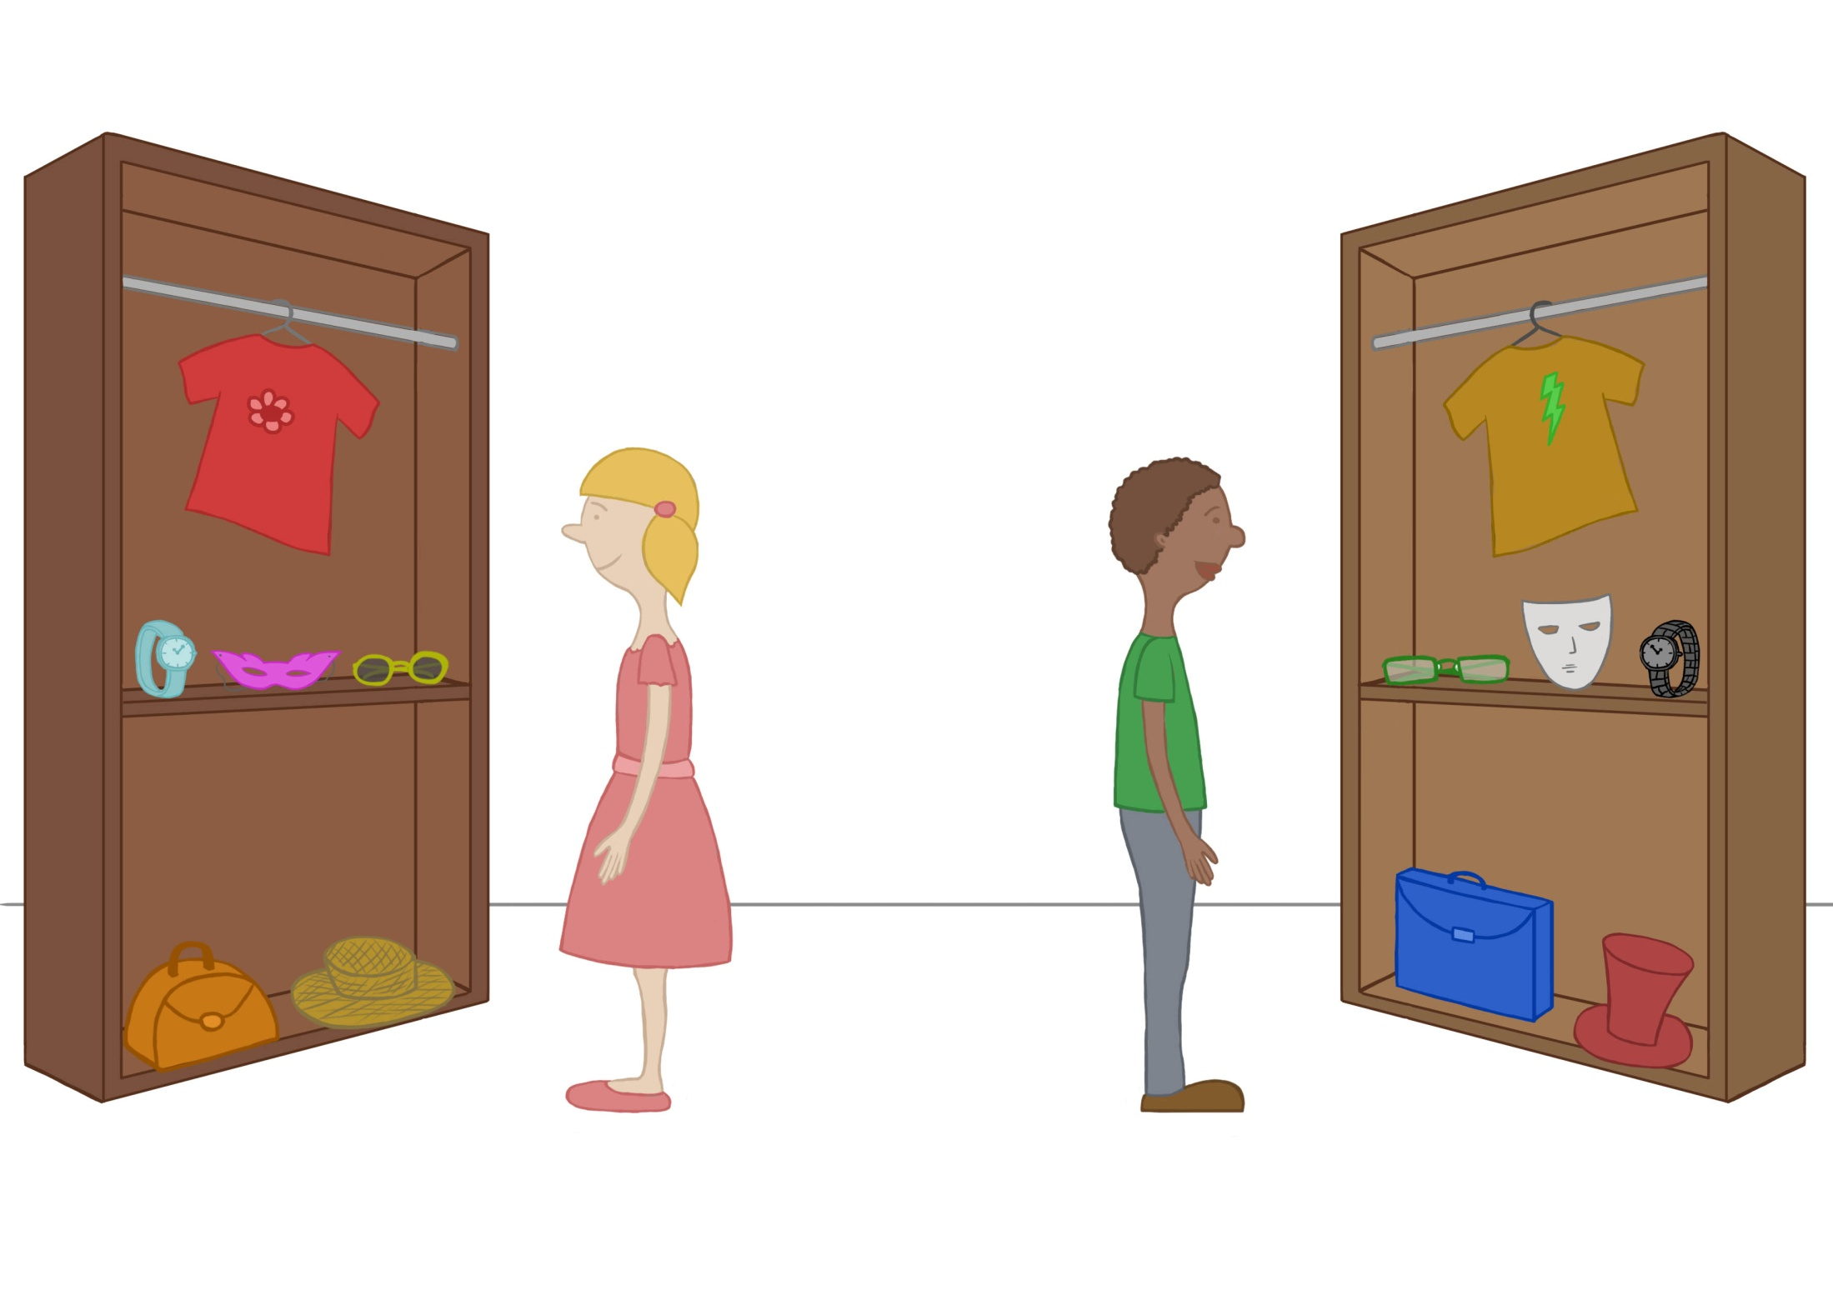

Slide 25
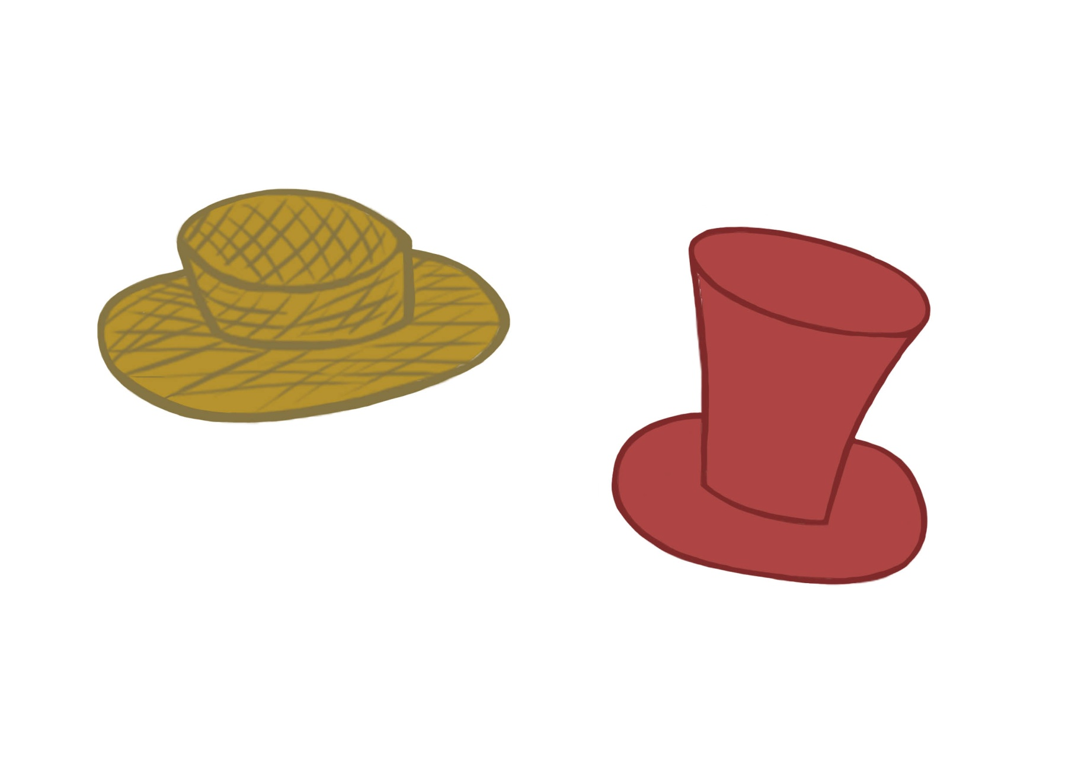

Slide 26
